Slide 1
Distributed Computing Seminar
Lecture 5: Graph Algorithms & PageRank
Christophe Bisciglia, Aaron Kimball, & Sierra Michels-Slettvet
Summer 2007
Except as otherwise noted, the content of this presentation is © 2007 Google Inc. and licensed under the Creative Commons Attribution 2.5 License.

Slide 2
Outline
Motivation
Graph Representations
Breadth-First Search & Shortest-Path Finding
PageRank

Slide 3
Motivating Concepts
Performing computation on a graph data structure requires processing at each node
Each node contains node-specific data as well as links (edges) to other nodes
Computation must traverse the graph and perform the computation step
How do we traverse a graph in MapReduce? How do we represent the graph for this?

Slide 4
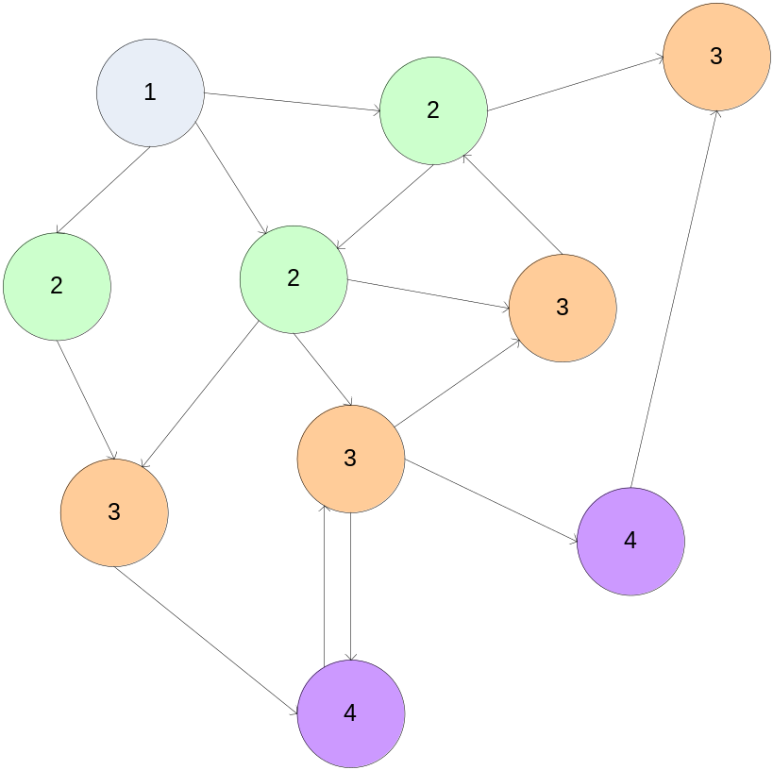
Breadth-First Search
Breadth-First Search is an iterated algorithm over graphs
Frontier advances from origin by one level with each pass

Slide 5
Breadth-First Search & MapReduce
Problem: This doesn't “fit” into MapReduce
Solution: Iterated passes through MapReduce – map some nodes, result includes additional nodes which are fed into successive MapReduce passes

Slide 6
Breadth-First Search & MapReduce
Problem: Sending the entire graph to a map task (or hundreds/thousands of map tasks) involves an enormous amount of memory
Solution: Carefully consider how we represent graphs

Slide 7
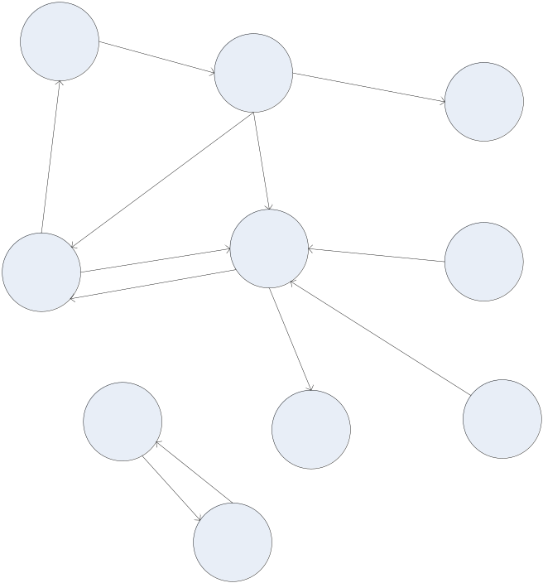
Graph Representations
The most straightforward representation of graphs uses references from each node to its neighbors

Slide 8
Direct References
Structure is inherent to object
Iteration requires linked list “threaded through” graph
Requires common view of shared memory (synchronization!)
Not easily serializable
class GraphNode
{
Object data;
Vector<GraphNode>
out_edges;
GraphNode
iter_next;
}

Slide 9
Adjacency Matrices
Another classic graph representation. M[i][j]= '1' implies a link from node i to j.
Naturally encapsulates iteration over nodes
1
2
3
4
1
0
1
0
1
2
1
0
1
1
3
0
1
0
0
4
1
0
1
0

Slide 10
Adjacency Matrices: Sparse Representation
Adjacency matrix for most large graphs (e.g., the web) will be overwhelmingly full of zeros.
Each row of the graph is absurdly long
Sparse matrices only include non-zero elements

Slide 11
Sparse Matrix Representation
1: (3, 1), (18, 1), (200, 1)
2: (6, 1), (12, 1), (80, 1), (400, 1)
3: (1, 1), (14, 1)
…

Slide 12
Sparse Matrix Representation
1: 3, 18, 200
2: 6, 12, 80, 400
3: 1, 14
…

Slide 13
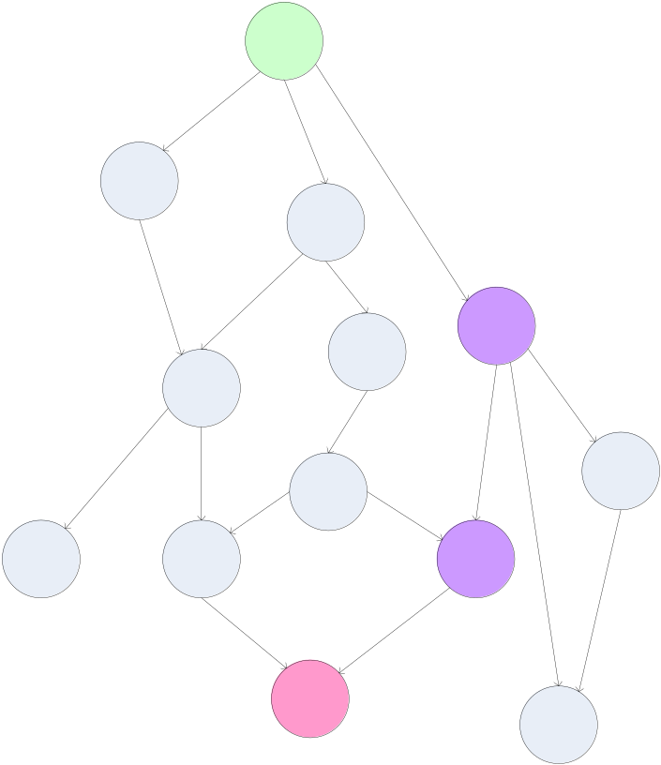
Finding the Shortest Path
A common graph search application is finding the shortest path from a start node to one or more target nodes
Commonly done on a single machine with Dijkstra's Algorithm
Can we use BFS to find the shortest path via MapReduce?
This is called the single-source shortest path problem. (a.k.a. SSSP)

Slide 14
Finding the Shortest Path: Intuition
We can define the solution to this problem inductively:
  DistanceTo(startNode) = 0
  For all nodes n directly reachable from startNode, DistanceTo(n) = 1
  For all nodes n reachable from some other set of nodes S,
    DistanceTo(n) = 1 + min(DistanceTo(m), m ∈ S)

Slide 15
From Intuition to Algorithm
A map task receives a node n as a key, and (D, points-to) as its value
  D is the distance to the node from the start
  points-to is a list of nodes reachable from n
∀p ∈ points-to, emit (p, D+1)
Reduce task gathers possible distances to a given p and selects the minimum one

Slide 16
What This Gives Us
This MapReduce task can advance the known frontier by one hop
To perform the whole BFS, a non-MapReduce component then feeds the output of this step back into the MapReduce task for another iteration
  Problem: Where'd the points-to list go?
  Solution: Mapper emits (n, points-to) as well

Slide 17
Blow-up and Termination
This algorithm starts from one node
Subsequent iterations include many more nodes of the graph as frontier advances
Does this ever terminate?
  Yes! Eventually, routes between nodes will stop being discovered and no better distances will be found. When distance is the same, we stop
  Mapper should emit (n, D) to ensure that “current distance” is carried into the reducer

Slide 18
Adding weights
Weighted-edge shortest path is more useful than cost==1 approach
Simple change: points-to list in map task includes a weight 'w' for each pointed-to node
  emit (p, D+w_{p}) instead of (p, D+1) for each node p
  Works for positive-weighted graph

Slide 19
Comparison to Dijkstra
Dijkstra's algorithm is more efficient because at any step it only pursues edges from the minimum-cost path inside the frontier
MapReduce version explores all paths in parallel; not as efficient overall, but the architecture is more scalable
Equivalent to Dijkstra for weight=1 case

Slide 20
PageRank: Random Walks Over The Web
If a user starts at a random web page and surfs by clicking links and randomly entering new URLs, what is the probability that s/he will arrive at a given page?
The PageRank of a page captures this notion
  More “popular” or “worthwhile” pages get a higher rank

Slide 21
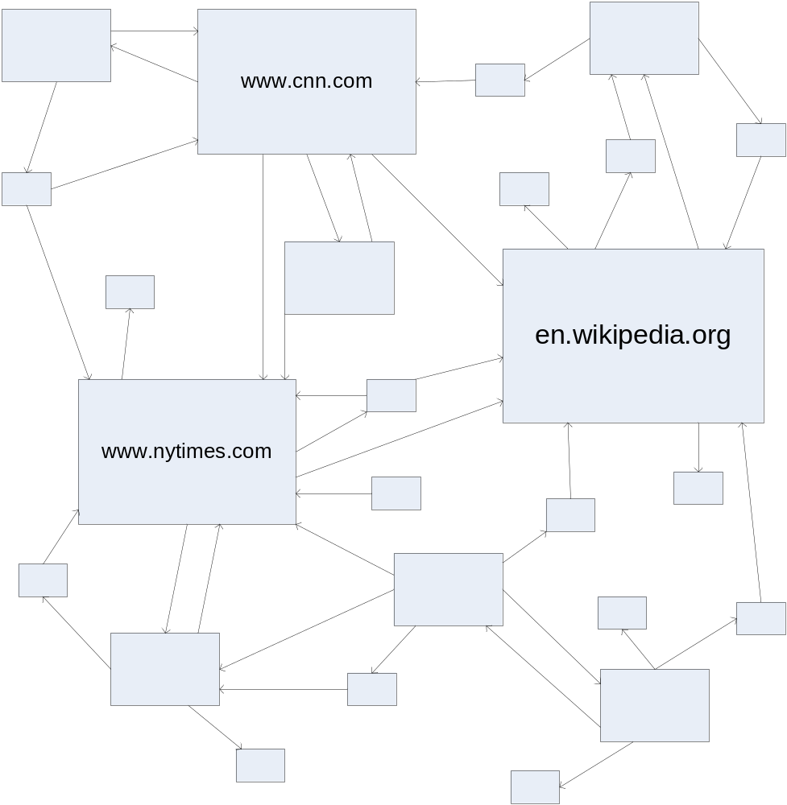
PageRank: Visually

Slide 22
PageRank: Formula
Given page A, and pages T₁ through T_{n} linking to A, PageRank is defined as:
PR(A) = (1-d) + d (PR(T₁)/C(T₁) + ... +
PR(T_{n})/C(T_{n}))
C(P) is the cardinality (out-degree) of page P
d is the damping (“random URL”) factor

Slide 23
PageRank: Intuition
Calculation is iterative: PR_{i+1} is based on PR_{i}
Each page distributes its PR_{i} to all pages it links to. Linkees add up their awarded rank fragments to find their PR_{i+1}
d is a tunable parameter (usually = 0.85) encapsulating the “random jump factor”
  PR(A) = (1-d) + d (PR(T₁)/C(T₁) + ... + PR(T_{n})/C(T_{n}))

Slide 24
PageRank: Issues
Is PageRank guaranteed to converge? How quickly?
What is the “correct” value of d, and how sensitive is the algorithm to it?
What is an efficient algorithm to solve this?

Slide 25
PageRank: First Implementation
Create two tables 'current' and 'next' holding the PageRank for each page. Seed 'current' with initial PR values
Iterate over all pages in the graph, distributing PR from 'current' into 'next' of linkees
current := next; next := fresh_table();
Go back to iteration step or end if converged

Slide 26
Distribution of the Algorithm
Key insights allowing parallelization:
  The 'next' table depends on 'current', but not on any other rows of 'next'
  Individual rows of the adjacency matrix can be processed in parallel
  Sparse matrix rows are relatively small

Slide 27
Distribution of the Algorithm
Consequences of insights:
  We can map each row of 'current' to a list of PageRank “fragments” to assign to linkees
  These fragments can be reduced into a single PageRank value for a page by summing
  Graph representation can be even more compact; since each element is simply 0 or 1, only transmit column numbers where it's 1

Slide 28
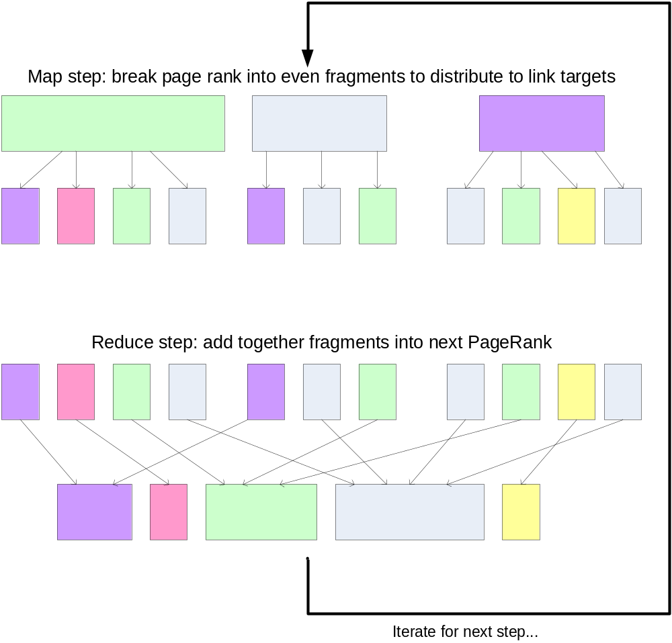

Slide 29
Phase 1: Parse HTML
Map task takes (URL, page content) pairs and maps them to (URL, (PR_{init}, list-of-urls))
  PR_{init} is the “seed” PageRank for URL
  list-of-urls contains all pages pointed to by URL
Reduce task is just the identity function

Slide 30
Phase 2: PageRank Distribution
Map task takes (URL, (cur_rank, url_list))
  For each u in url_list, emit (u, cur_rank/|url_list|)
  Emit (URL, url_list) to carry the points-to list along through iterations
  PR(A) = (1-d) + d (PR(T₁)/C(T₁) + ... + PR(T_{n})/C(T_{n}))

Slide 31
Phase 2: PageRank Distribution
Reduce task gets (URL, url_list) and many (URL, val) values
  Sum vals and fix up with d
  Emit (URL, (new_rank, url_list))
  PR(A) = (1-d) + d (PR(T₁)/C(T₁) + ... + PR(T_{n})/C(T_{n}))

Slide 32
Finishing up...
A non-parallelizable component determines whether convergence has been achieved (Fixed number of iterations? Comparison of key values?)
If so, write out the PageRank lists - done!
Otherwise, feed output of Phase 2 into another Phase 2 iteration

Slide 33
Conclusions
MapReduce isn't the greatest at iterated computation, but still helps run the “heavy lifting”
Key element in parallelization is independent PageRank computations in a given step
Parallelization requires thinking about minimum data partitions to transmit (e.g., compact representations of graph rows)
  Even the implementation shown today doesn't actually scale to the whole Internet; but it works for intermediate-sized graphs

